Slide 1

Part 1:
Series: Imaging Science Tools
Generating flexible scientific figures with Matlab
Prof. Dr. Moritz Zaiss
Max-Planck Institute for biological cybernetics, Tübingen
University Clinic Erlangen, Friedrich-Alexander University (FAU) Erlangen-Nürnberg
moritz.zaiss@fau.de
Outline:
Templates for coherent size and style
Interactive changes for fast adaption
Exporting as vectors graphics
https://www.youtube.com/watch?v=ur0cTY8sQ0M

Slide 2

Scientific figures – requirements in research
Design coherent with main document
(font type, font size, line width, etc.)
Flexible to change, interactively
after feedback from colleagues, supervisors or reviewers
Exportable as vector graphics
eps, svg, ppt
Document text

Slide 3
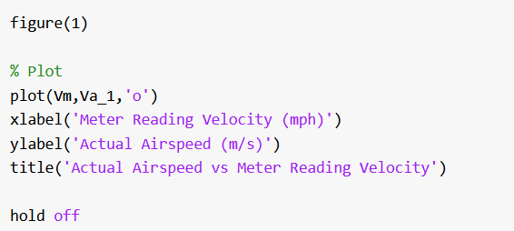
Code-based approach
Everything is defined in the code
Pro: The cleanest solution, direct link to the data
Problem: if a change is required, you have to change your code

Slide 4
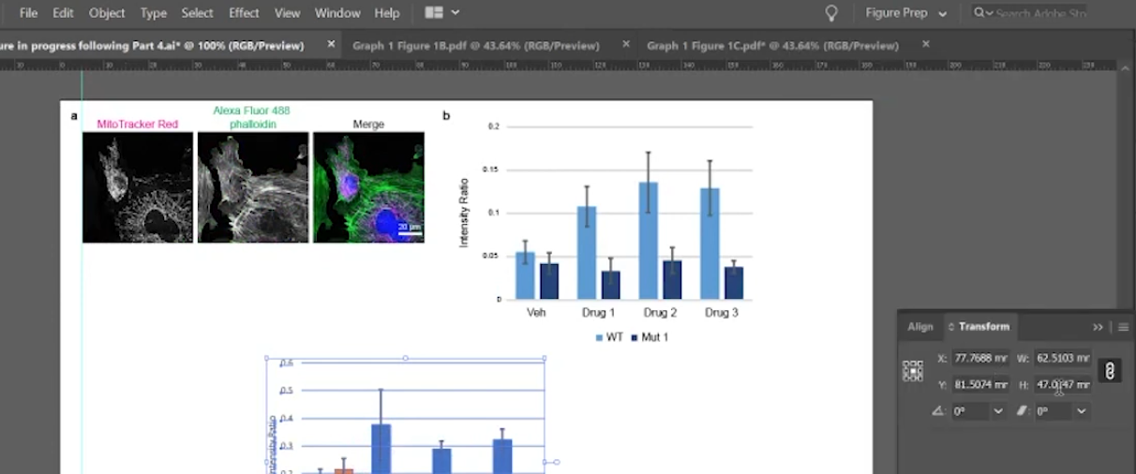
Illustration-based approach
figures are finalized in an illustration tool: Inkscape, Illustrator, Powerpoint, etc.
Pro: Most beautiful figures and illustrations possible
Problem: if a data change is required you have to redo the figure again, there is no direct link to the data

Slide 5
Matlab figures as a hybrid approach
figures are generated with Matlab code and interactively finalized
Pro: Code links to data, data is also stored in the figures
Pro: Fast changes in design, arrangement and data possible

Slide 6
Slides, screencast, and code on github
https://github.com/cest-sources/imaging_science_tools
https://www.youtube.com/watch?v=ur0cTY8sQ0M

Slide 7
Summary
Matlab figures provide hybrid approach to generate scientific figures
Flexible
Linked to data
Exportable to vector graphics
Matlab available via Campus license
https://github.com/cest-sources/imaging_science_tools
moritz.zaiss@fau.de

